Slide 1


Fundamentals of Data Science
Coursera Course Dataset
Its time to learn best
George Youhana
Pavli Bahaa
DR. Essam Seddik
Eng. Aya Mohamed

Slide 2

Table of contents
01
02
03
04
Context
Describtion About the Dataset
Main Goal
The main goal
Dataset Content
Detailed Content about data set (6columns)
Data Cleaning
Delete Unnecessary Column
ML Module
05
06
Recommendation & Dashboard

Slide 3

Context
Course dataset scrapped from Coursera website

Slide 4

82,000,000
Coursera reached 82 million registered users in 2021

Slide 5

Dataset Context:
Our problem :
Many students enrolled in numerous courses from various websites, such as Coursera and Udemy, but had no idea whether the course would be beneficial to them, whether it would have good content, or whether it would be compatible with their level.
This dataset is about Coursera courses. Hence, we had to scrape data from a few educational websites. This is data scraped from the Coursera website. We collected information about courses and their specifications over many years.
Article about the dataset generation :
https://medium.com/analytics-vidhya/web-scraping-and-coursera-8db6af45d83f

Slide 6

Main goal
Our project aims to help any new learner get the right course to learn ,by making an intelligent course recommendation system.

Slide 7
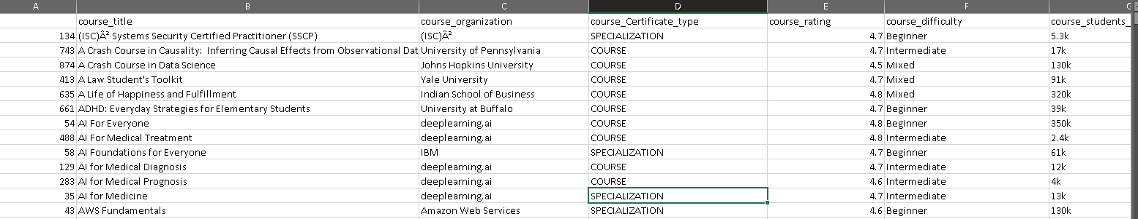
Screenshot of Dataset

Slide 8
Dataset Content:
This is a slide structure based on a presentation for education
You can delete this slide when you’re done editing the presentation
course_title | Contains the course title.
course_organization | It tells which organization is conducting the courses.
courseCertificatetype | It has details about what are the different certifications available in courses.
course_rating | It has the ratings associated with each course.
course_difficulty | It tells about how difficult or what is the level of the course.
coursestudentsenrolled | It has the number of students that are enrolled in the course.

Slide 9
Project Plan
Correlation Analysis -ML Model
Idea
Idea and planning
Correlation between columns
7th-8th
9th -
10th
11th-12th
13th
Data Wrangling
Data Filtering
Data Cleaning
Data Visulaization
Final
Presentation

Slide 10
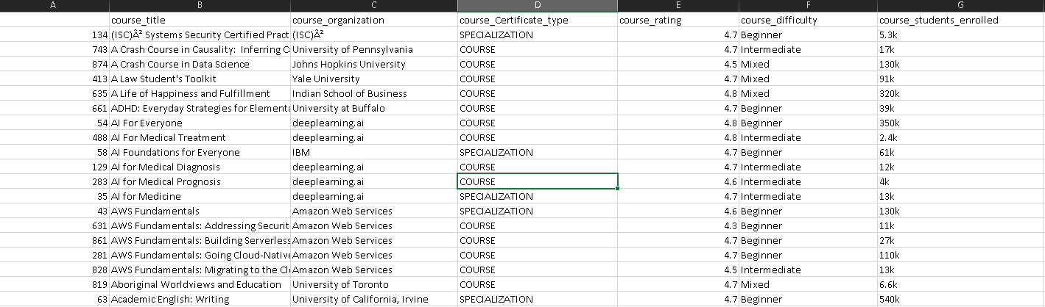
Before Cleaning

Slide 11
Initial plan for data exploration
Data Cleaning
Deleting first Unnamed column
Renaming the column "course_Certificate_type" to "Certficate type"
Removing duplicate values

Slide 12
Initial plan for data exploration
Data Cleaning
Handling missing data (Nan and None values)
Extracting numerical values in the column "course_students_enrolled"
Modifying the "course_difficulty" column for further use

Slide 13
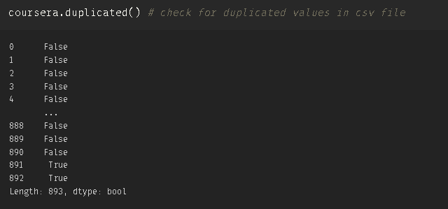
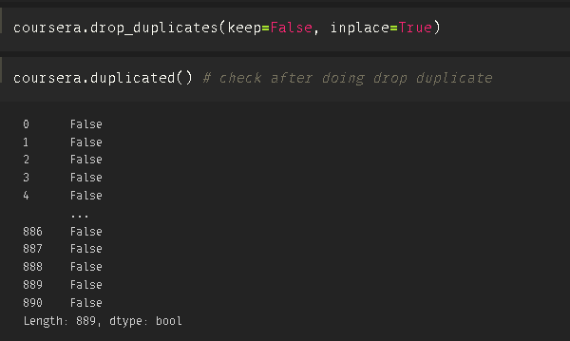
Checking Duplicate

Slide 14
Modifying the "course_difficulty" column
Mixed==0.5
Intermediate==1
Beginner ==0
Advanced==2
Else ==0
Convert it
to Numeric

Slide 15
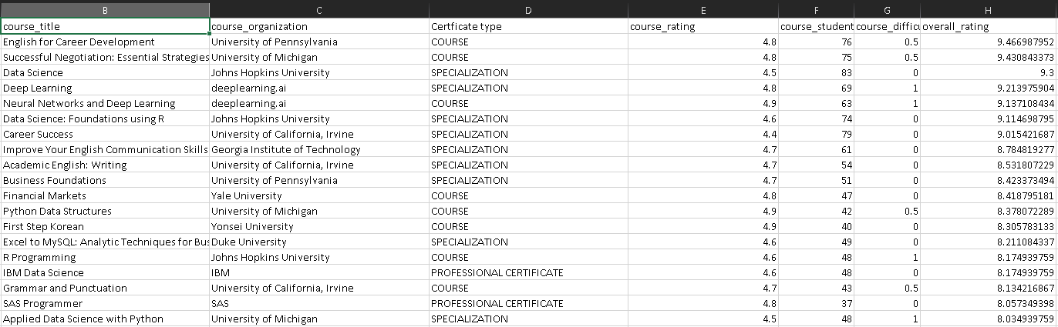
After Cleaning

Slide 16
Using Aggregate Function
Mean =4.6
Median=4.7
Min=3.3
Max=5.0
Course
Rating

Slide 17
Correlation Analysis

Slide 18
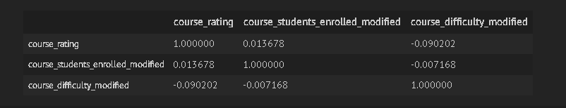
Result Correlation Analysis

Slide 19
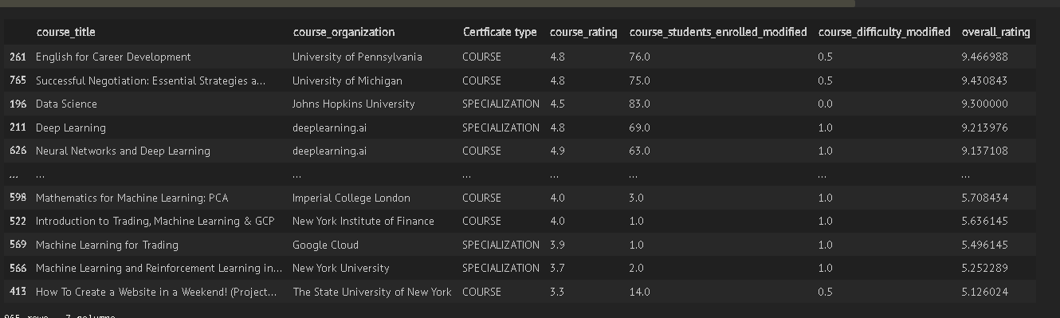
Adding New Column overall Rating
By making equation for course rating and course student enrolled modified taking both
maximin and storing descending

Slide 20
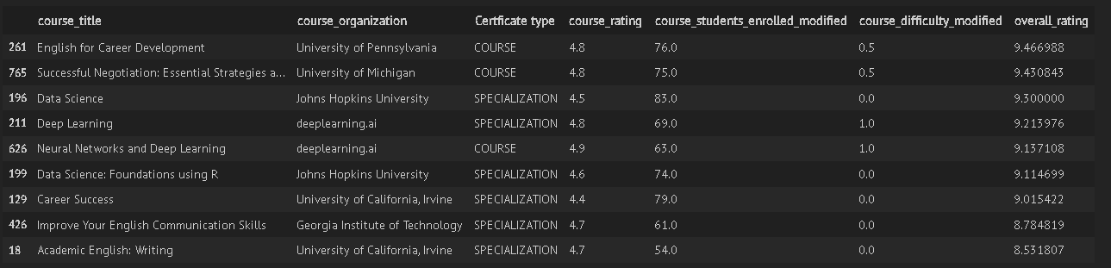
Finaaaaaaal
Coursera-Best

Slide 21
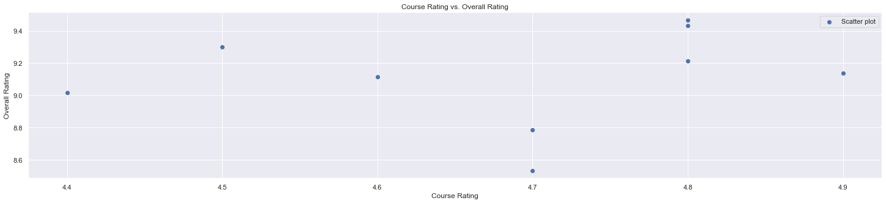
Scatterplot

Slide 22
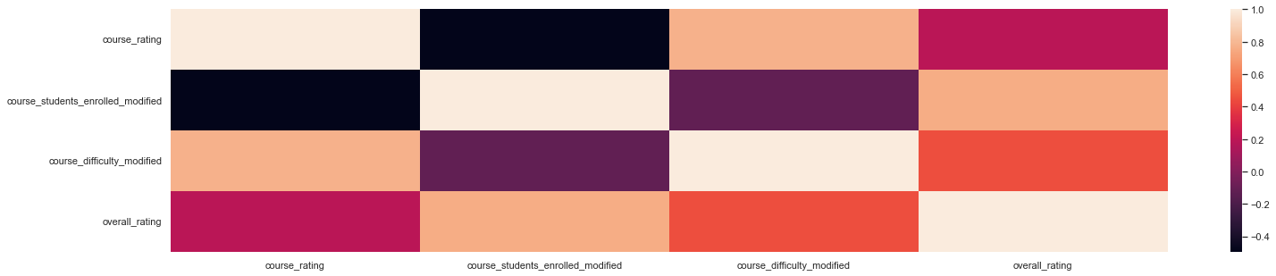
Heatmap Correlation

Slide 23
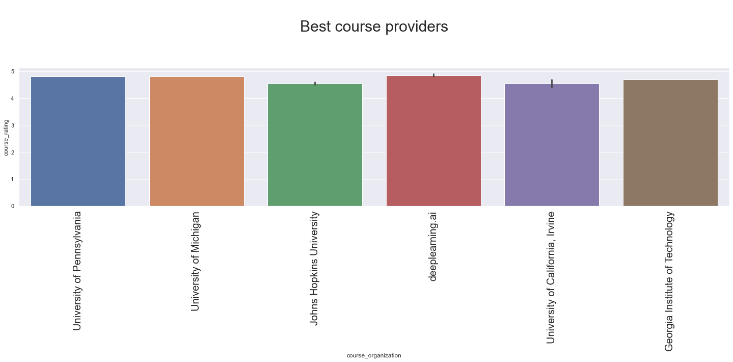

Slide 24
ML -Module
Linear Regression
Calculate Mean Absolute Error
mean squared error, mean absolute error and the R-squared
Plotting the data and the linear regression line
calculating the model accuracy

Slide 25
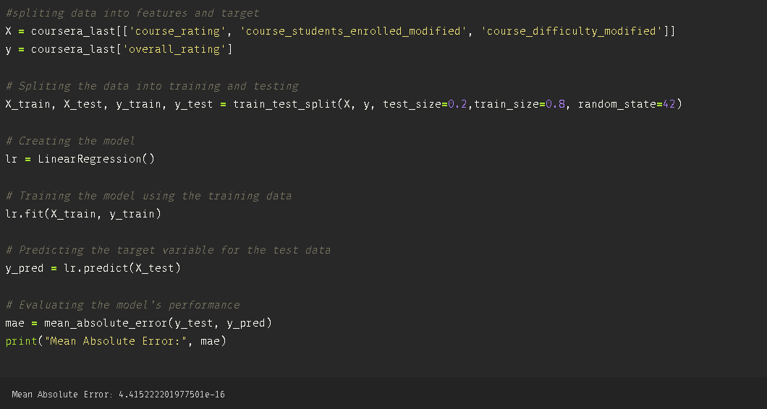
ML -Module
Linear Regression

Slide 26

ML -Module
Linear Regression

Slide 27
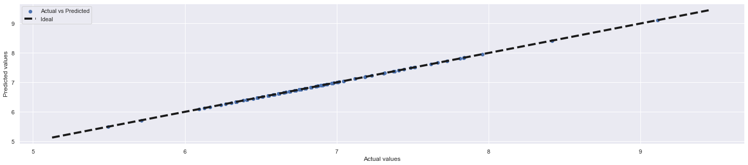
ML -Module
Linear Regression
Ploting the data and the linear regression line
*note: the linear regression model will attempt to find the line of best fit that describes the relationship between the independent variables (course rating, course students enrolled modified, and course difficulty modified) and the dependent variable (overall rating).

Slide 28
ML -Module
Linear Regression
Mean Squared Error
4.415
Accuracy
1.0
Mean Absolute error
4.017
R Squared
1.0

Slide 29
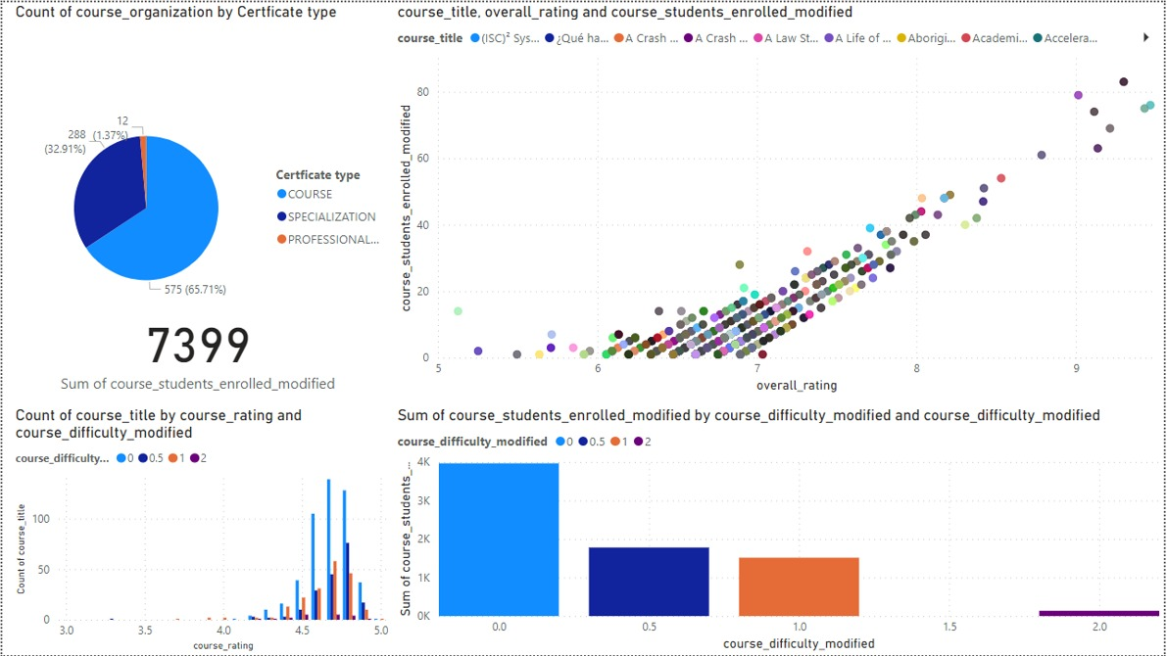
Dashboard

Slide 30
Our Recommendation
Use more diverse feature
Improve the quality of the data
any courses provider that rating over 8.5
Using Deep learning Ai as best course service provide

Slide 31
Thanks!

